Slide 1
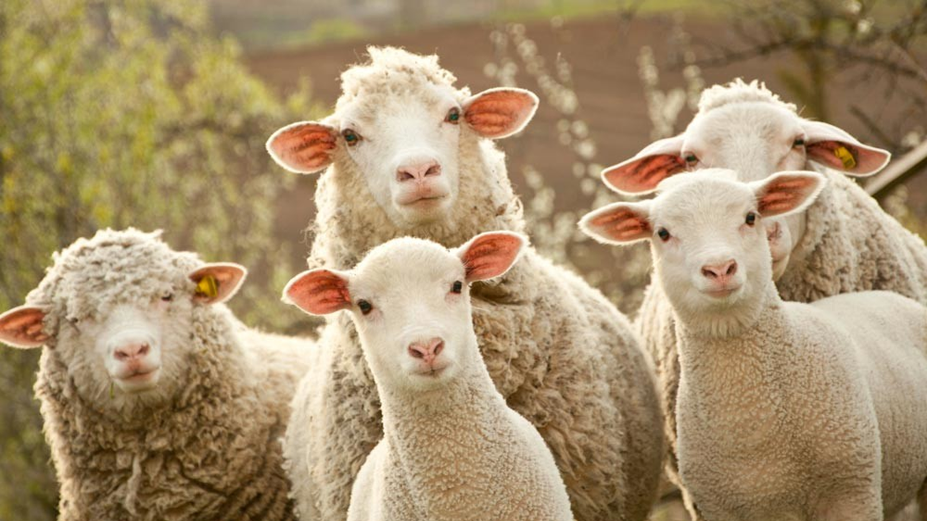
Saul’s Rebellion Against God’s Word
1 Samuel 15:1-11

Slide 2
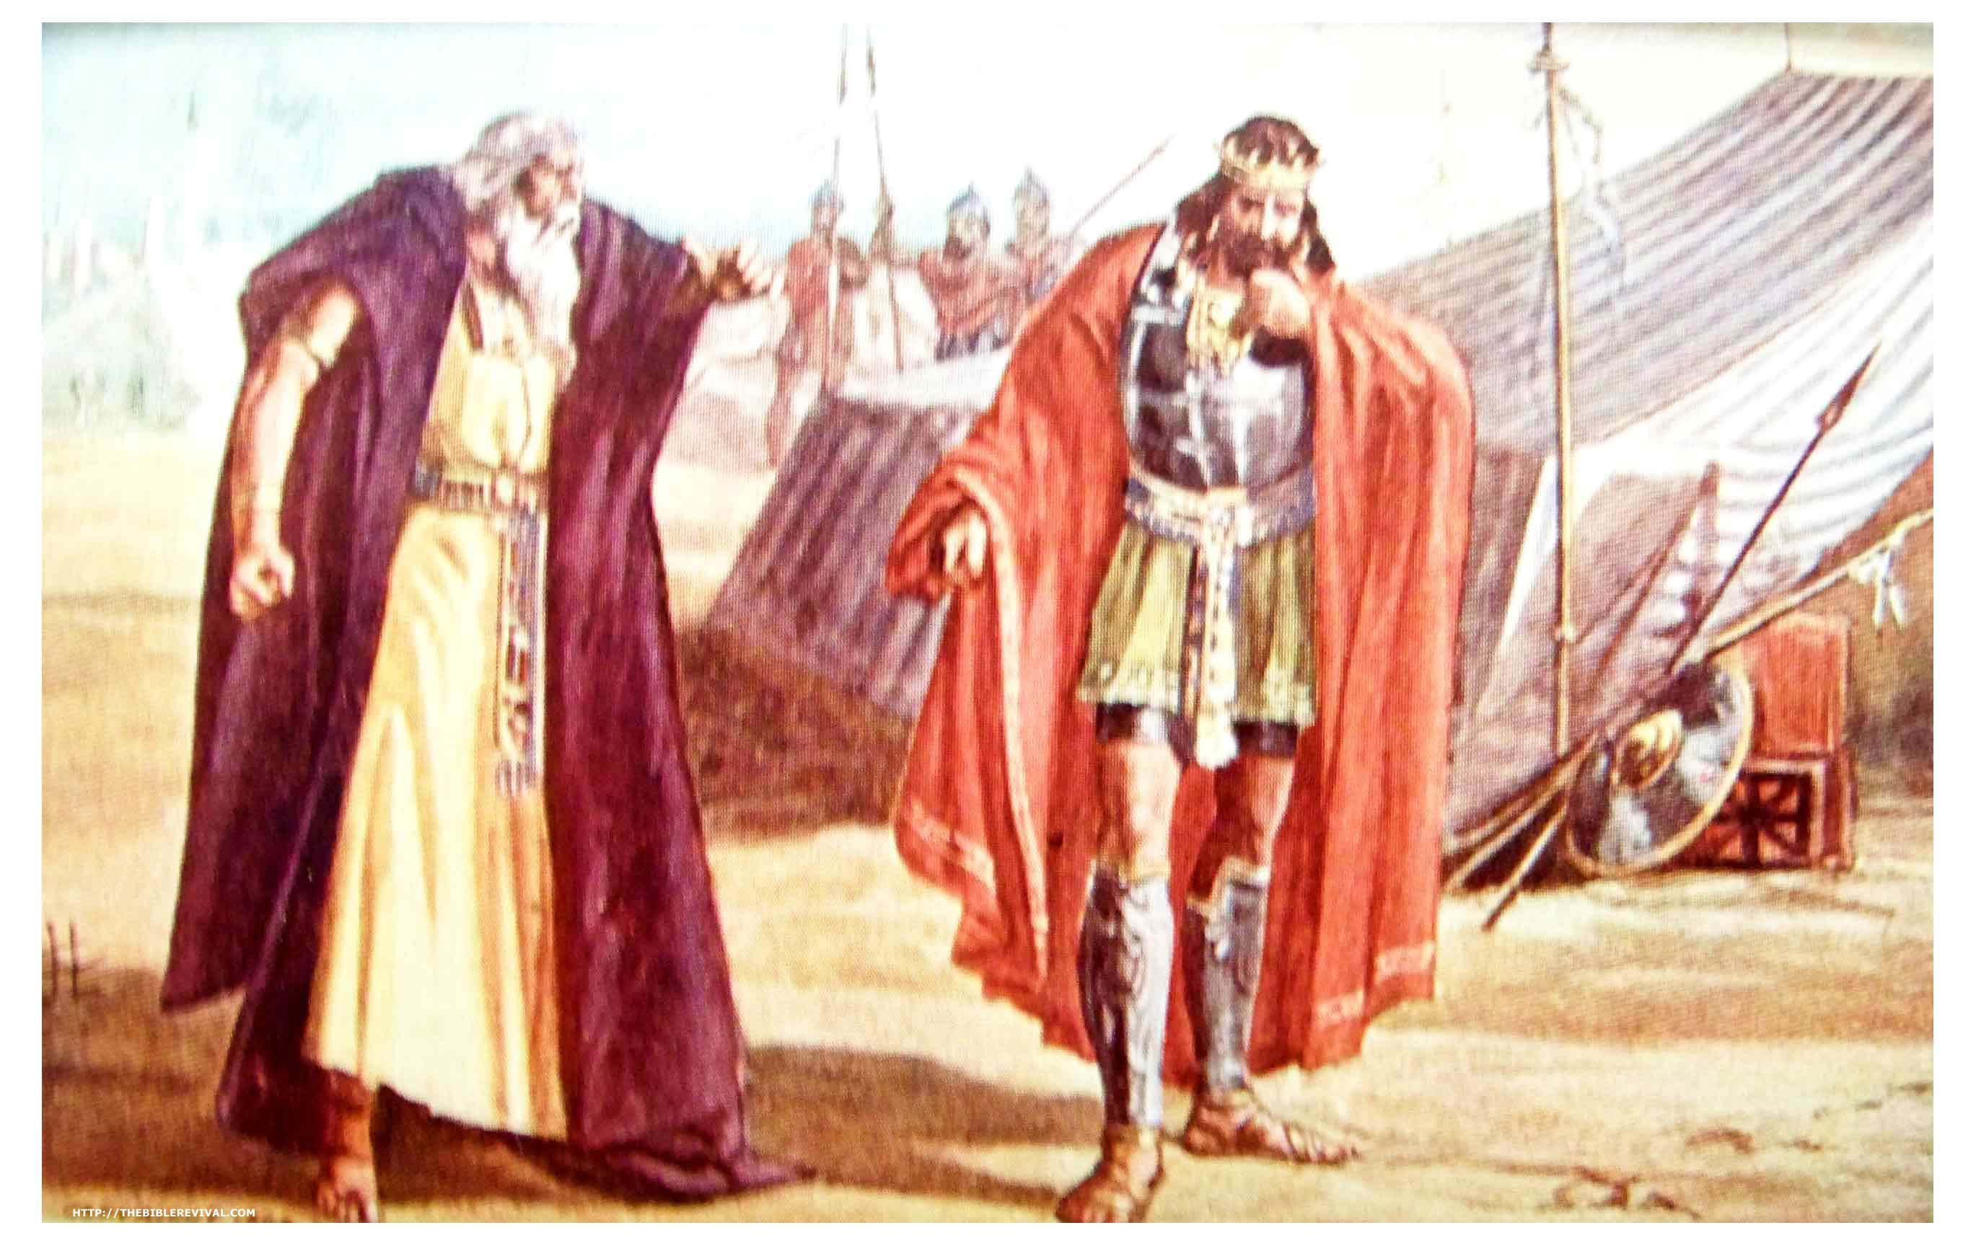
God’s command to Saul.
Remember where you came from.
Amalek’s sin and damnation.
  The Amalekites came from Esau’s line.

Slide 3
Genesis 36:12 And Timna was concubine to Eliphaz Esau's son; and she bare to Eliphaz Amalek: these were the sons of Adah Esau's wife.

Slide 4
God’s command to Saul.
Amalek’s sin and damnation.
  Amalek was Israel’s enemy.
  Amalek wasn’t just fighting against Israel, but God Himself!
  Israel was God’s vehicle to bring redemption to the entire world.
  Amalek was Satan’s vehicle to try and end them.

Slide 5
Exodus 17:8-16 Then came Amalek, and fought with Israel in Rephidim.
13 And Joshua discomfited Amalek and his people with the edge of the sword. 14 And the LORD said unto Moses, Write this for a memorial in a book, and rehearse it in the ears of Joshua: for I will utterly put out the remembrance of Amalek from under heaven. 15 And Moses built an altar, and called the name of it Jehovahnissi: 16 For he said, Because the LORD hath sworn that the LORD will have war with Amalek from generation to generation.

Slide 6
God’s command to Saul.
Amalek’s sin and damnation.
  Amalek wasn’t just fighting against Israel, but God Himself!
  Israel was God’s vehicle to bring redemption to the entire world.
  Amalek was Satan’s vehicle to try and end them.

Slide 7
Numbers 14:41-45 And Moses said, Wherefore now do ye transgress the commandment of the LORD? but it shall not prosper. 42 Go not up, for the LORD is not among you; that ye be not smitten before your enemies. 43 For the Amalekites and the Canaanites are there before you, and ye shall fall by the sword: because ye are turned away from the LORD, therefore the LORD will not be with you. 44 But they presumed to go up unto the hill top: nevertheless the ark of the covenant of the LORD, and Moses, departed not out of the camp. 45 Then the Amalekites came down, and the Canaanites which dwelt in that hill, and smote them, and discomfited them, even unto Hormah.

Slide 8
Numbers 24:20 And when he looked on Amalek, he took up his parable, and said, Amalek was the first of the nations; but his latter end shall be that he perish for ever.

Slide 9
Deuteronomy 25:17-19 Remember what Amalek did unto thee by the way, when ye were come forth out of Egypt; 18 How he met thee by the way, and smote the hindmost of thee, even all that were feeble behind thee, when thou wast faint and weary; and he feared not God. 19 Therefore it shall be, when the LORD thy God hath given thee rest from all thine enemies round about, in the land which the LORD thy God giveth thee for an inheritance to possess it, that thou shalt blot out the remembrance of Amalek from under heaven; thou shalt not forget it.

Slide 10
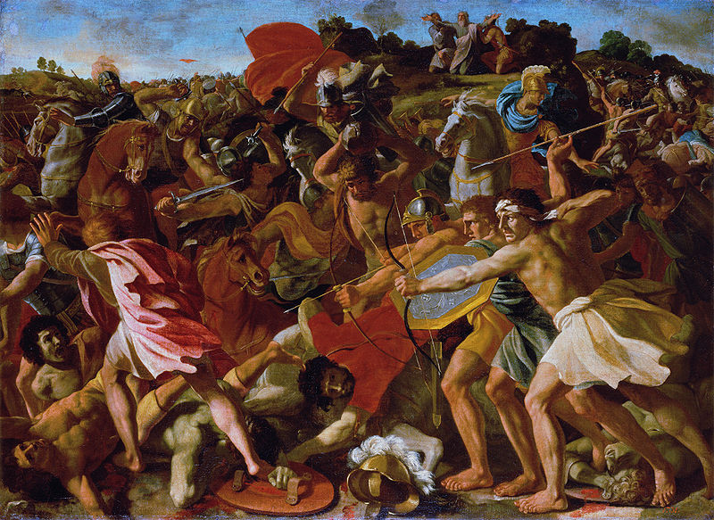
Is God too harsh?.
Critics point to passages like this and try to make God a monster.
  God hates sin.
  He is not willing that any perish. From the time Amalek first attacked Israel, to the time their judgment was commanded was 400years!
  God is longsuffering!

Slide 11
2 Peter 3:9 The Lord is not slack concerning his promise, as some men count slackness; but is longsuffering to us-ward, not willing that any should perish, but that all should come to repentance.

Slide 12
John 3:17-21 For God sent not his Son into the world to condemn the world; but that the world through him might be saved. 18 He that believeth on him is not condemned: but he that believeth not is condemned already, because he hath not believed in the name of the only begotten Son of God. 19 And this is the condemnation, that light is come into the world, and men loved darkness rather than light, because their deeds were evil. 20 For every one that doeth evil hateth the light, neither cometh to the light, lest his deeds should be reproved. 21 But he that doeth truth cometh to the light, that his deeds may be made manifest, that they are wrought in God.

Slide 13
Saul’s beginning obedience.
Saul allowed the Kenites to escape = good!
God takes good care of those that take care of Israel!

Slide 14
Genesis 12:2-3 And I will make of thee a great nation, and I will bless thee, and make thy name great; and thou shalt be a blessing: 3 And I will bless them that bless thee, and curse him that curseth thee: and in thee shall all families of the earth be blessed.

Slide 15
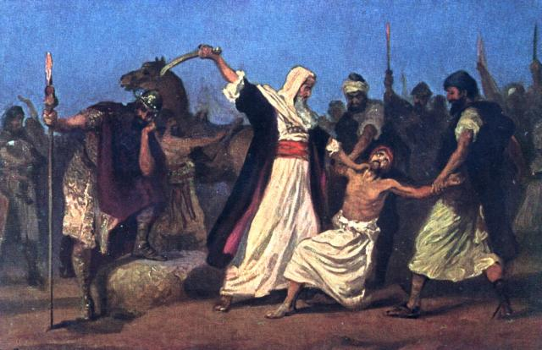
Saul’s ultimate disobedience.
Man’s perspective – we can easily let go of things we see no value in.
They destroyed “every thing that was vile and refuse,”
It’s hard to cut of things that we value!
God said it was rejected!

Slide 16
Philippians 3:8 Yea doubtless, and I count all things but loss for the excellency of the knowledge of Christ Jesus my Lord: for whom I have suffered the loss of all things, and do count them but dung, that I may win Christ,

Slide 17
Danger! Success, power, leadership of others can all easily go to the head and corrupt the heart.
When you don’t take God seriously. When you don’t tremble before His Word.
Jesus deserved everything. When He was offered everything (all the kingdoms of the world) Jesus stayed submitted to Scripture.

Slide 18
Luke 4:8 And Jesus answered and said unto him, Get thee behind me, Satan: for it is written, Thou shalt worship the Lord thy God, and him only shalt thou serve.

Slide 19
Saul’s ultimate disobedience.
In serving himself, Saul didn’t really fulfil what was commanded in vs 3!

Slide 20
1 Samuel 30:1-4 And it came to pass, when David and his men were come to Ziklag on the third day, that the Amalekites had invaded the south, and Ziklag, and smitten Ziklag, and burned it with fire; 2 And had taken the women captives, that were therein: they slew not any, either great or small, but carried them away, and went on their way. 3 So David and his men came to the city, and, behold, it was burned with fire; and their wives, and their sons, and their daughters, were taken captives. 4 Then David and the people that were with him lifted up their voice and wept, until they had no more power to weep.

Slide 21
Many times, the reason we fail… we don’t finish!
Colossians 3:23 And whatsoever ye do, do it heartily, as to the Lord, and not unto men;

Slide 22
Problem: When the Word of God isn’t authoritative over our lives. We come to the place where we think we know better than the Word!
God’s regret and Samuel’s grief!
Coming up SHORT in obeying God. Rom 3:23
Result? Loss of the kingdom!
This is a picture of the Judgment Seat of Christ.

Slide 23
2 Timothy 2:11-13 It is a faithful saying: For if we be dead with him, we shall also live with him: 12 If we suffer, we shall also reign with him: if we deny him, he also will deny us: 13 If we believe not, yet he abideth faithful: he cannot deny himself.

Slide 24
1 John 2:15-17 Love not the world, neither the things that are in the world. If any man love the world, the love of the Father is not in him. 16 For all that is in the world, the lust of the flesh, and the lust of the eyes, and the pride of life, is not of the Father, but is of the world. 17 And the world passeth away, and the lust thereof: but he that doeth the will of God abideth for ever.

Slide 25
